Slide 1
Model-View-Controller (MVC)

Slide 2
Objectives
Define MVC and explain why it matters
Creating a data layer
Creating a view layer
Creating a controller (logic/route handler) layer

Slide 3
What is MVC
A common software design pattern that separates an application into 3 distinct logical components:
Model
View
Controller

Slide 4
Model
The “data” layer of the application
All data writes, retrievals, and data-related logic are done in this layer
In MVC app, interaction with DB is only done in the Model or data layer

Slide 5
View
View layer contains the UI/UX components and UI/UX logic of the app
It consists of all the frontend topics we have covered:
HTML, CSS, frontend JS, DOM
Additionally, it also covers Template Engines, eg. EJS, Pug, Blade, etc
Will talk more about them, for now, think of them as HTML templates on steroids

Slide 6
Controller
Controller is the “glue” and logic layers of the MVC pattern
Interacts with Model layer to retrieve/write data
Interacts with View layer to display the UI, passing along data from the Model layer

Slide 7
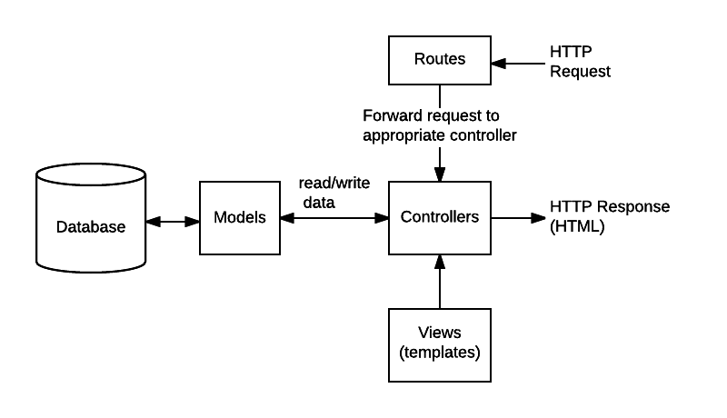
ExpressJS MVC Lifecycle

Slide 8
MVC Advantages
MVC advantages:
Separation of concerns, no “spaghetti code”, solidifies the approach and structure for the application
Easier for teams to work in parallel. Someone could be working on the model layer, another could work on view layer for example

Slide 9
30 mins
Remember express-params lab exercise in previous class? Let us convert that to use MVC pattern.
Extract the usernames variable into model layer
Create models folder, in it create users.js
Extract out the usernames variable into users.js , then export the variable
Create controllers folder, in it create user_controller.js
Extract out the anonymous function in the query param route, put it into the controller file

